Slide 1
Dubai Restaurant Selection
Mohammad Sukhon
May 2020

Slide 2
Introduction
Popular restaurant in Abu Dhabi looking to relocate to Dubai
Will use Machine Learning and Data science to help them select optimal location in Dubai
The following are the main criteria for community selection:
Large population density
Large number of venues which indicates strong business sentiment
Demographics: o Young, single or small family
Predominantly European, North American and Western mindset
Large influx of business visitors and leisure tourists
Surrounded by other similar communities to facilitate delivery / pick up
Consists of popular destination such as a Zoo Safari, Beach, entertainment park..etc

Slide 3
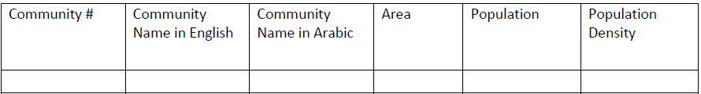
Data Collection / Preparation
To get census data about the different communities in Dubai, we used the following Wikipedia link: https://en.wikipedia.org/wiki/List_of_communities_in_Dubai
We get a table having the following structure:
The Lat/lon data will be collected from Geopy
The venue information will be collected from the Foursquare API

Slide 4
Dubai Community Distribution

Slide 5
Methodology
Initially data cleansing was needed to get the data frame in a processing friendly format
K-selection was critical; as low K value was highly sensitive to outliers and resulted in suboptimal clusters
Using the elbow method, we arrived an optimal K value of 13 which results in five major clusters

Slide 6
Results
After conducting the K-means clustering, we get 13 clusters, 5 of which are meaningful while the rest are single community clusters (such as Warqa 5 which is effectively a Zoo Safari) and can be treated as outliers.

Slide 7
Discussion 1/2
After carefully inspecting the clusters (details in the Appendix); we could identify a unique one which predominantly consists of Hotels and restaurants (cluster 6). Given that tourists and business visitors are a main customer segment that we want to attract, our community selection will fall in this cluster.
If we inspect the tables from the previous section; we get an intersection of four communities (densely populated and have a high venue count): Naif, Al Karama, Al Muraqqabat and Marsa Dubai. Out of this set, only Marsa Dubai, Naif and Al Muraqqabat fall in the cluster 6. After doing some external research, we decided to rule out Naif and Al Muraqqabat because these are non-touristic areas and are located on the ghetto side of Dubai. Most of the hotels in these two communities are old and non-rated and hence have relatively low occupancy rate.

Slide 8
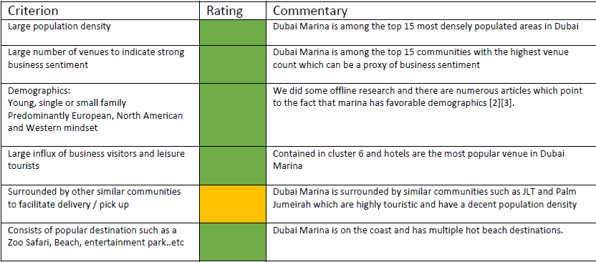
Discussion 2/2
This multi-tiered selection process has helped us arrive at Marsa Dubai which is popularly called Dubai Marina. It satisfies all the criteria that we initially set; here is a quick recap:

Slide 9
Conclusion
We have developed a multi-tiered community selection framework which incorporates machine learning and external research to arrive at an optimal restaurant location using several elements as proxy for potential demand or revenue. The data needed for this framework are readily available public data which can be applied to most major cities globally. We can further refine this framework by incorporating also the cost side of the equation in the form of rent, special permits, supply chain and others.
The framework developed can be part of a compelling business case to be presented to prospect investors.

